Slide 1

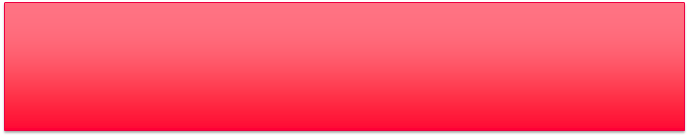
Специализированные технологии машинного обучения / Advanced Machine learning Technologies
Lecture 2 – Reinforcement Learning

Slide 2
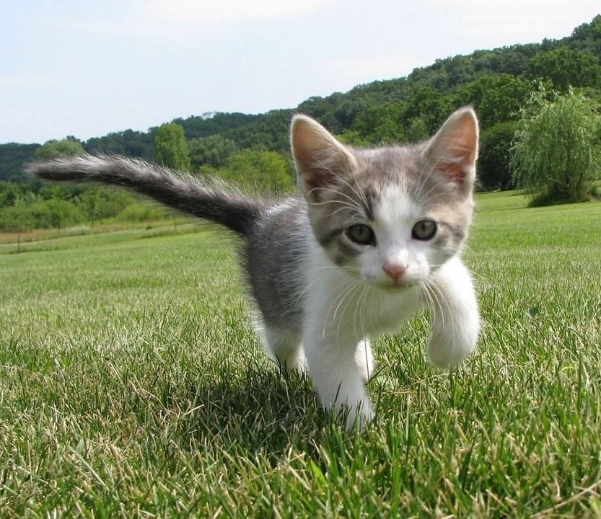
Supervised Learning
Data: (x, y)
x is data, y is label
Goal: Learn a function to map x -> y
Cat
Examples: Classification, regression, object detection, semantic segmentation, image captioning, etc.
Classification
This image is CC0 public domain
Lecture 14 -
2

Slide 3
Unsupervised Learning
Data: x
Just data, no labels!
Goal: Learn some underlying hidden structure of the data
Examples: Clustering, dimensionality reduction, feature learning, density estimation, etc.
density estimation
Lecture 14 -
3

Slide 4
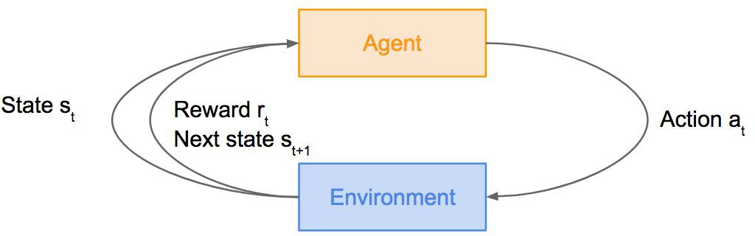
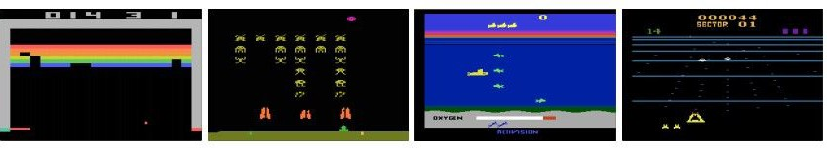
Reinforcement Learning
Problems involving an agent interacting with an environment, which provides numeric reward signals
Goal: Learn how to take actions in order to maximize reward
Lecture 14 -
4

Slide 5
Reinforcement Learning
Problems involving an agent interacting with an environment, which provides numeric reward signals
Goal: Learn how to take actions in order to maximize reward
A person learns how to walk not by looking through a huge number of teaching examples, but by trying new things and making mistakes, so that, by getting both positive and negative experience
Lecture 14 -
5

Slide 6
Overview
What is Reinforcement Learning?
Markov Decision Processes
Q-Learning
Policy Gradients
*partly based on CS231n Stanford RL lecture
6

Slide 7
Reinforcement Learning
Agent
State s_{t}
Reward r_{t} Next state s
Action a
t
t+1
Environment
Lecture 14 - 7

Slide 8
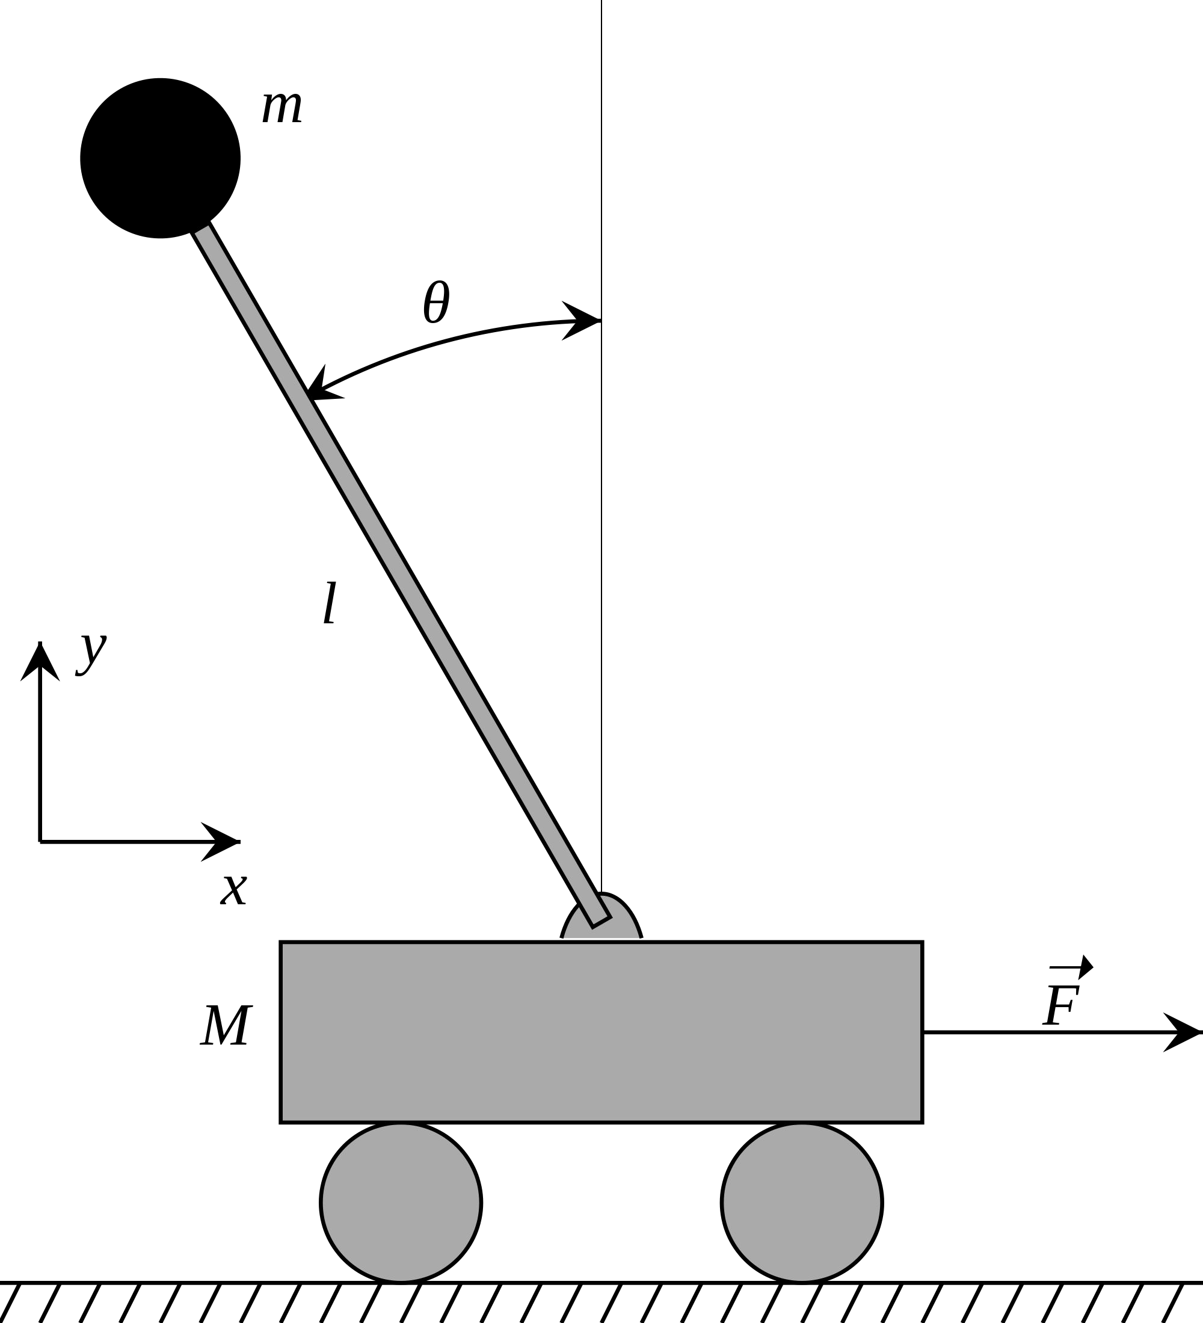
Cart-Pole Problem
Objective: Balance a pole on top of a movable cart
State: angle, angular speed, position, horizontal velocity
Action: horizontal force applied on the cart
Reward: 1 at each time step if the pole is upright
This image is CC0 public domain
Lecture 14 -

Slide 9
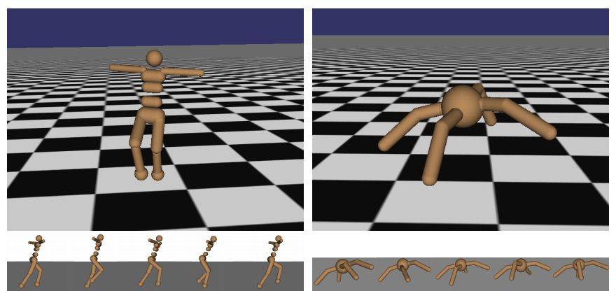
Robot motions
Objective: Make the robot move forward
State: Angle and position of the joints Action: Torques applied on joints Reward: 1 at each time step upright + forward movement
Lecture 14 -

Slide 10
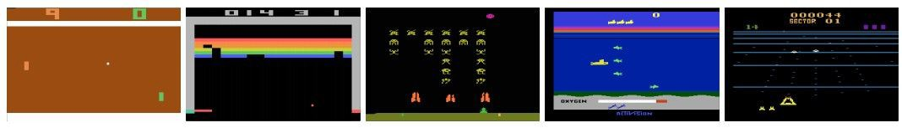
Atari Games
Objective: Complete the game with the highest score
State: Raw pixel inputs of the game state
Action: Game controls e.g. Left, Right, Up, Down
Reward: Score increase/decrease at each time step
Lecture 14 -

Slide 11
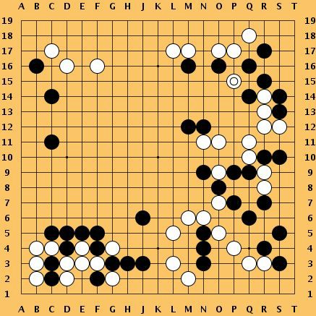
Go
Objective: Win the game!
State: Position of all pieces
Action: Where to put the next piece down
Reward: 1 if win at the end of the game, 0 otherwise
This image is CC0 public domain
Lecture 14 -

Slide 12
How can we mathematically formalize the RL problem?
Agent
State s_{t}
Reward r_{t} Next state s
Action a
t
t+1
Environment

Slide 13

Markov Decision Process
Mathematical formulation of the RL problem
Markov property: Current state completely characterises the state of the world
Process is defined by:
: set of possible states
: set of possible actions
: distribution of reward given (state, action) pair
: transition probability i.e. distribution over next state given (state, action) pair
: discount factor – the less it is the less objective depends on further rewards

Slide 14

Markov Decision Process
At time step t=0, environment samples initial state s₀ ~ p(s₀)
Then, for t=0 until done:
Agent selects action a_{t}
Environment samples reward r_{t} ~ R( . | s_{t}, a_{t})
Environment samples next state s_{t+1} ~ P( . | s_{t}, a_{t})
Agent receives reward r_{t} and next state s_{t+1}
A policy π is a function from S to A that specifies what action to take in each state
Objective: find policy π* that maximizes cumulative discounted reward:

Slide 15
A simple MDP: Grid World
states
actions = {
right
left
up
down
★
 |  |  | ★
Set a negative “reward” for each transition
(e.g. r = -1)
}
Objective: reach one of terminal states (greyed out) in least number of actions

Slide 16



A simple MDP: Grid World
★
 |  |  | ★
★
 |  |  | ★
Random Policy
Optimal Policy

Slide 17
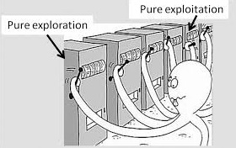
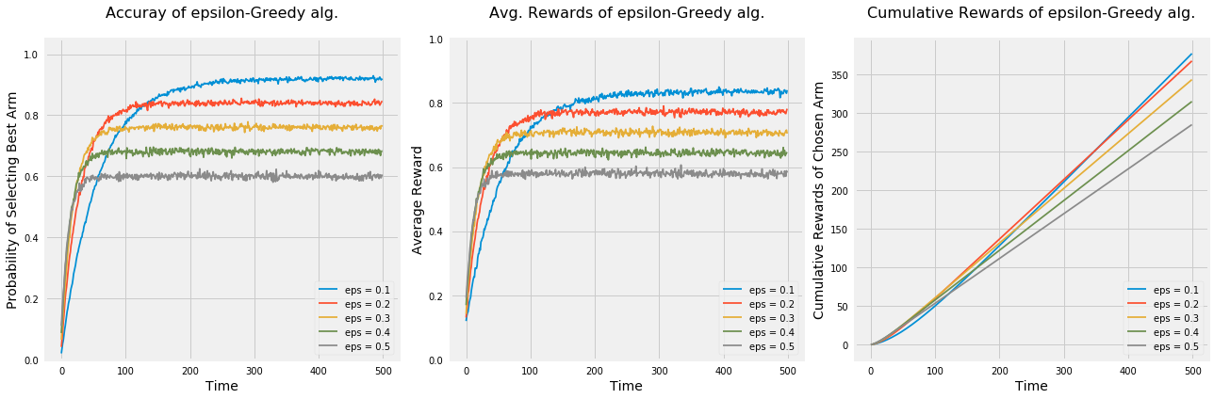
“Multi-armed bandits”
Assume that we have the following setup:
Several automates with different reward probability (give money)
Push the arms to earn more money (Our goal is to maximize reward with t→ ∞)
No different states for agent – only actions with reward;
How to choose the best one? (say, «the best policy”)
Greedy algorithm: on every step we choose the arm with the highest reward.
Exploration algorithm: on every step choose another arm in a hope that it will give even more reward.
ɛ-greedy algorithm: with probability (1-ɛ) we perform in greedy way and with ɛ we explore the system.

Slide 18

The optimal policy п*
We want to find optimal policy п* that maximizes the sum of rewards.
How do we handle the randomness (initial state, transition probability…)? Maximize the expected sum of rewards!
Formally:
with

Slide 19
Definitions: Value function and Q-value function
Following a policy produces sample trajectories (or paths) s₀, a₀, r₀, s₁, a₁, r₁, …
How to estimate how good the current state is?

Slide 20
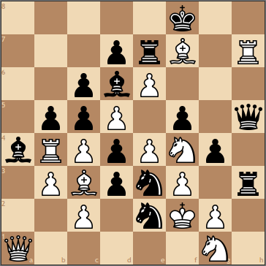
Chess
Reward is known only in the end of a game….
How good the current state is?
How to choose the next step?

Slide 21


Definitions: Value function and Q-value function
Following a policy produces sample trajectories (or paths) s₀, a₀, r₀, s₁, a₁, r₁, …
How good is a state?
The value function at state s, is the expected cumulative reward from following the policy from state s:
How good is a state-action pair?
The Q-value function at state s and action a, is the expected cumulative reward from taking action a in state s and then following the policy:

Slide 22
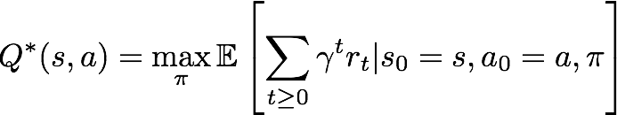


Bellman equation
The optimal Q-value function Q* is the maximum expected cumulative reward achievable from a given (state, action) pair:
Q* satisfies the following Bellman equation:
Intuition: if the optimal state-action values for the next time-step Q*(s’,a’) are known, then the optimal strategy is to take the action that maximizes the expected value of
The optimal policy π* corresponds to taking the best action in any state as specified by Q*

Slide 23

Solving for the optimal policy
Value iteration algorithm: Use Bellman equation as an iterative update
Q_{i} will converge to Q* as i -> infinity
What’s the problem with this?
Not scalable. Must compute Q(s,a) for every state-action pair. If state is e.g. current game state pixels, computationally infeasible to compute for entire state space!
Solution: use a function approximator to estimate Q(s,a). E.g. a neural network!

Slide 24

Solving for the optimal policy: Q-learning
Q-learning: Use a function approximator to estimate the action-value function
function parameters (weights)
If the function approximator is a deep neural network => deep q-learning!

Slide 25

Solving for the optimal policy: Q-learning
Remember: want to find a Q-function that satisfies the Bellman Equation:
Forward Pass Loss function:
where
Backward Pass
Gradient update (with respect to Q-function parameters θ):

Slide 26
Case Study: Playing Atari Games
Objective: Complete the game with the highest score
State: Raw pixel inputs of the game state
Action: Game controls e.g. Left, Right, Up, Down
Reward: Score increase/decrease at each time step
[Mnih et al. NIPS Workshop 2013; Nature 2015]

Slide 27

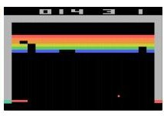
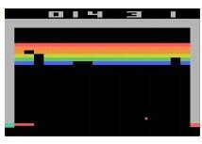
Q-network Architecture
[Mnih et al. NIPS Workshop 2013; Nature 2015]
:
neural network with weights
FC-4 (Q-values)
FC-256
32 4x4 conv, stride 2
16 8x8 conv, stride 4
Current state s_{t}: 84x84x4 stack of last 4 frames
(after RGB->grayscale conversion, downsampling, and cropping)

Slide 28
Q-network Architecture
[Mnih et al. NIPS Workshop 2013; Nature 2015]
:
neural network with weights
FC-4 (Q-values)
FC-256
32 4x4 conv, stride 2
16 8x8 conv, stride 4
Input: state s_{t}
Current state s_{t}: 84x84x4 stack of last 4 frames
(after RGB->grayscale conversion, downsampling, and cropping)

Slide 29
Q-network Architecture
[Mnih et al. NIPS Workshop 2013; Nature 2015]
:
neural network with weights
FC-4 (Q-values)
FC-256
Familiar conv layers, FC layer
32 4x4 conv, stride 2
16 8x8 conv, stride 4
Current state s_{t}: 84x84x4 stack of last 4 frames
(after RGB->grayscale conversion, downsampling, and cropping)

Slide 30
Q-network Architecture
[Mnih et al. NIPS Workshop 2013; Nature 2015]
:
neural network with weights
Last FC layer has 4-d
output (if 4 actions), corresponding to Q(s_{t}, a₁), Q(s_{t}, a₂), Q(s_{t}, a₃), Q(s_{t},a₄)
FC-4 (Q-values)
FC-256
32 4x4 conv, stride 2
16 8x8 conv, stride 4
Current state s_{t}: 84x84x4 stack of last 4 frames
(after RGB->grayscale conversion, downsampling, and cropping)

Slide 31
Q-network Architecture
[Mnih et al. NIPS Workshop 2013; Nature 2015]
:
neural network with weights
Last FC layer has 4-d
output (if 4 actions), corresponding to Q(s_{t}, a₁), Q(s_{t}, a₂), Q(s_{t}, a₃), Q(s_{t},a₄)
FC-4 (Q-values)
FC-256
32 4x4 conv, stride 2
16 8x8 conv, stride 4
Number of actions between 4-20 depending on Atari game
Current state s_{t}: 84x84x4 stack of last 4 frames
(after RGB->grayscale conversion, downsampling, and cropping)

Slide 32
Q-network Architecture
[Mnih et al. NIPS Workshop 2013; Nature 2015]
:
neural network with weights
Last FC layer has 4-d
output (if 4 actions), corresponding to Q(s_{t}, a₁), Q(s_{t}, a₂), Q(s_{t}, a₃), Q(s_{t},a₄)
FC-4 (Q-values)
FC-256
32 4x4 conv, stride 2
A single feedforward pass to compute Q-values for all actions from the current state => efficient!
16 8x8 conv, stride 4
Number of actions between 4-20 depending on Atari game
Current state s_{t}: 84x84x4 stack of last 4 frames
(after RGB->grayscale conversion, downsampling, and cropping)

Slide 33
Solving for the optimal policy: Q-learning
Remember: want to find a Q-function that satisfies the Bellman Equation:
Forward Pass Loss function:
where
Backward Pass
Gradient update (with respect to Q-function parameters θ):

Slide 34
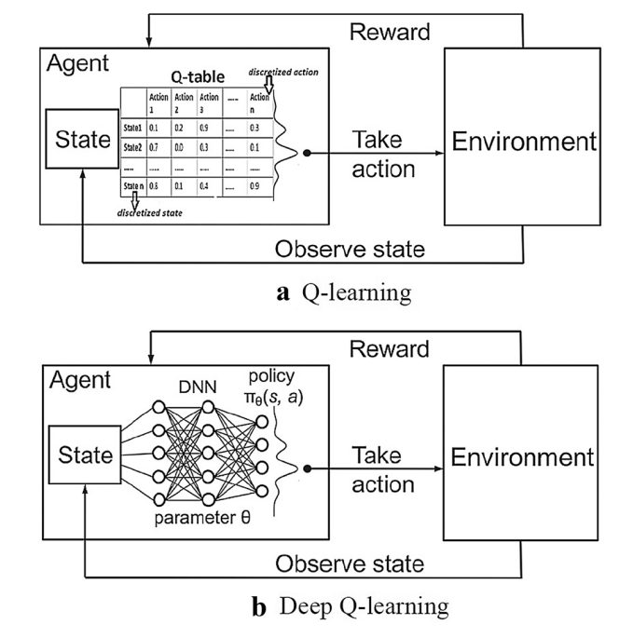
Q-learning and Deep Q-learning

Slide 35
Training the Q-network: Experience Replay
Learning from batches of consecutive samples is problematic:
Samples are correlated => inefficient learning
Current Q-network parameters determines next training samples (e.g. if maximizing action is to move left, training samples will be dominated by samples from left-hand size) => can lead to bad feedback loops
Address these problems using experience replay
Continually update a replay memory table of transitions (s_{t}, a_{t}, r_{t}, s_{t+1}) as game (experience) episodes are played
Train Q-network on random minibatches of transitions from the replay memory,
instead of consecutive samples
Each transition can also contribute to multiple weight updates
=> greater data efficiency

Slide 36
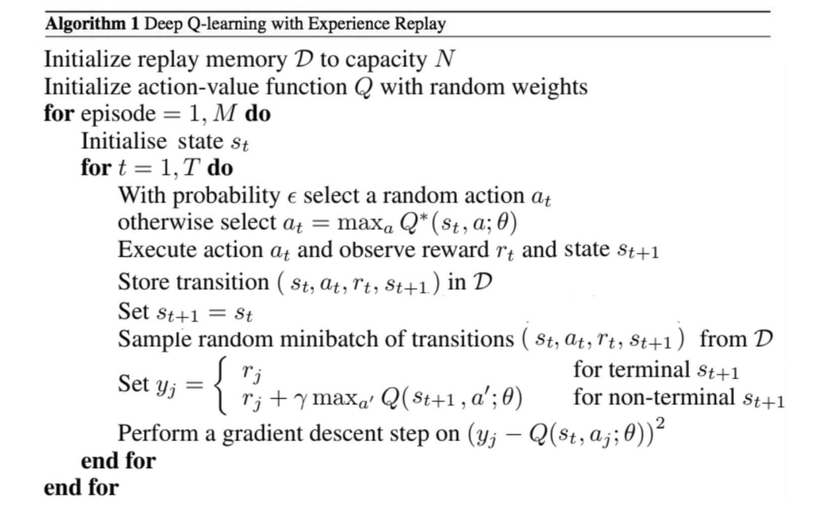
Putting it together: Deep Q-Learning with Experience Replay

Slide 37
Putting it together: Deep Q-Learning with Experience Replay
Initialize replay memory, Q-network

Slide 38
Putting it together: Deep Q-Learning with Experience Replay
Play M episodes (full games)

Slide 39
Putting it together: Deep Q-Learning with Experience Replay
Initialize state (starting game screen pixels) at the beginning of each episode

Slide 40
Putting it together: Deep Q-Learning with Experience Replay
For each timestep t of the game

Slide 41
Putting it together: Deep Q-Learning with Experience Replay
With small probability, select a random action (explore), otherwise select greedy action from current policy

Slide 42
Putting it together: Deep Q-Learning with Experience Replay
Take the action (a_{t}), and observe the reward r_{t} and next state s_{t+1}

Slide 43
Putting it together: Deep Q-Learning with Experience Replay
Store transition in
replay memory

Slide 44
Putting it together: Deep Q-Learning with Experience Replay
Experience Replay:
Sample a random minibatch of transitions from replay memory and perform a gradient descent step

Slide 45
Environments for experiments!
https://www.gymlibrary.dev/environments/atari/breakout/
Example!
https://www.youtube.com/watch?v=V1eYniJ0Rnk

Slide 46
Policy Gradients
What is a problem with Q-learning?
The Q-function can be very complicated!
Example: a robot grasping an object has a very high-dimensional state => hard to learn exact value of every (state, action) pair

Slide 47
Policy Gradients
What is a problem with Q-learning?
The Q-function can be very complicated!
Example: a robot grasping an object has a very high-dimensional state => hard to learn exact value of every (state, action) pair
But the policy can be much simpler: just close your hand
Can we learn a policy directly, e.g. finding the best policy from a collection of policies?

Slide 48

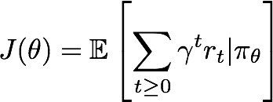
Policy Gradients
Formally, let’s define a class of parametrized policies:
For each policy, define its value:

Slide 49

Policy Gradients
Formally, let’s define a class of parametrized policies:
For each policy, define its value:
We want to find the optimal policy
How can we do this?

Slide 50
Policy Gradients
Formally, let’s define a class of parametrized policies:
For each policy, define its value:
We want to find the optimal policy
How can we do this?
Gradient ascent on policy parameters!

Slide 51
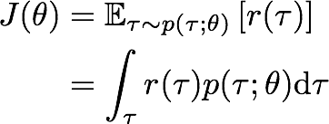

REINFORCE algorithm
Mathematically, we can write:
Where r(т) is the reward of a trajectory

Slide 52

REINFORCE algorithm
Expected reward:
Now let’s differentiate this:
Intractable! Gradient of an expectation is problematic when p depends on θ
Can be estimated with Monte Carlo sampling!

Slide 53
More policy gradients: AlphaGo
AlphaGo - overview:
Mix of supervised learning and reinforcement learning
Mix of old methods (Monte Carlo Tree Search) and recent ones (deep RL)
How to beat the Go world champion:
Featurize the board (stone color, move legality, bias, …)
Initialize policy network with supervised training from professional go games, then continue training using policy gradient (play against itself from random previous iterations, +1 / -1 reward for winning / losing)
Also learn value network (critic)
Finally, combine policy and value networks in a Monte Carlo Tree Search algorithm to select actions by lookahead search
[Silver et al., Nature 2016]
This image is CC0 public domain
Lecture 14 -

Slide 54
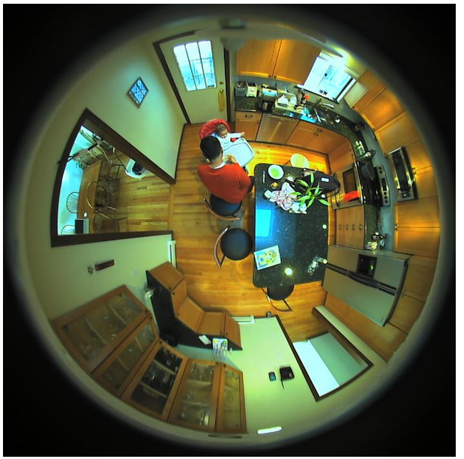
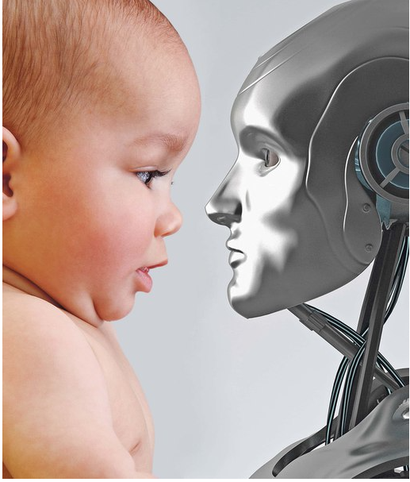
Deb Roy’s MIT experiment
90 000 hours video
140 000 hours audio
http://ai-news.ru/2018/04/kak_obuchautsya_deti_i_pochemu_iskusstvennyj_intellekt_tak_ne_mozhet.html

